Slide 1
RFID Card Reader
The SPI interface

Slide 2
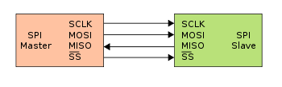
Serial Peripheral Interface
Dedicated line for each direction of communication

Slide 3
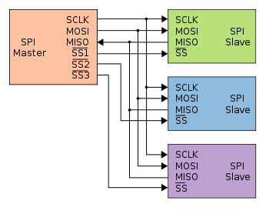
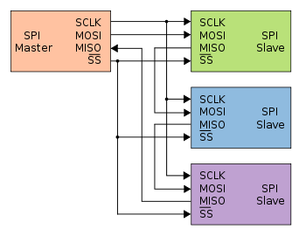
Multiple slaves
There are different configurations for multiple slaves
We’re only using one slave

Slide 4
Configuring the Pi
sudo raspi-config
Interfaces -> Enable SPI
reboot the Pi

Slide 5
What is RFID?
Radio Frequency IDentification
https://youtu.be/gEQJxNDSKAE
No battery, wireless communication

Slide 6
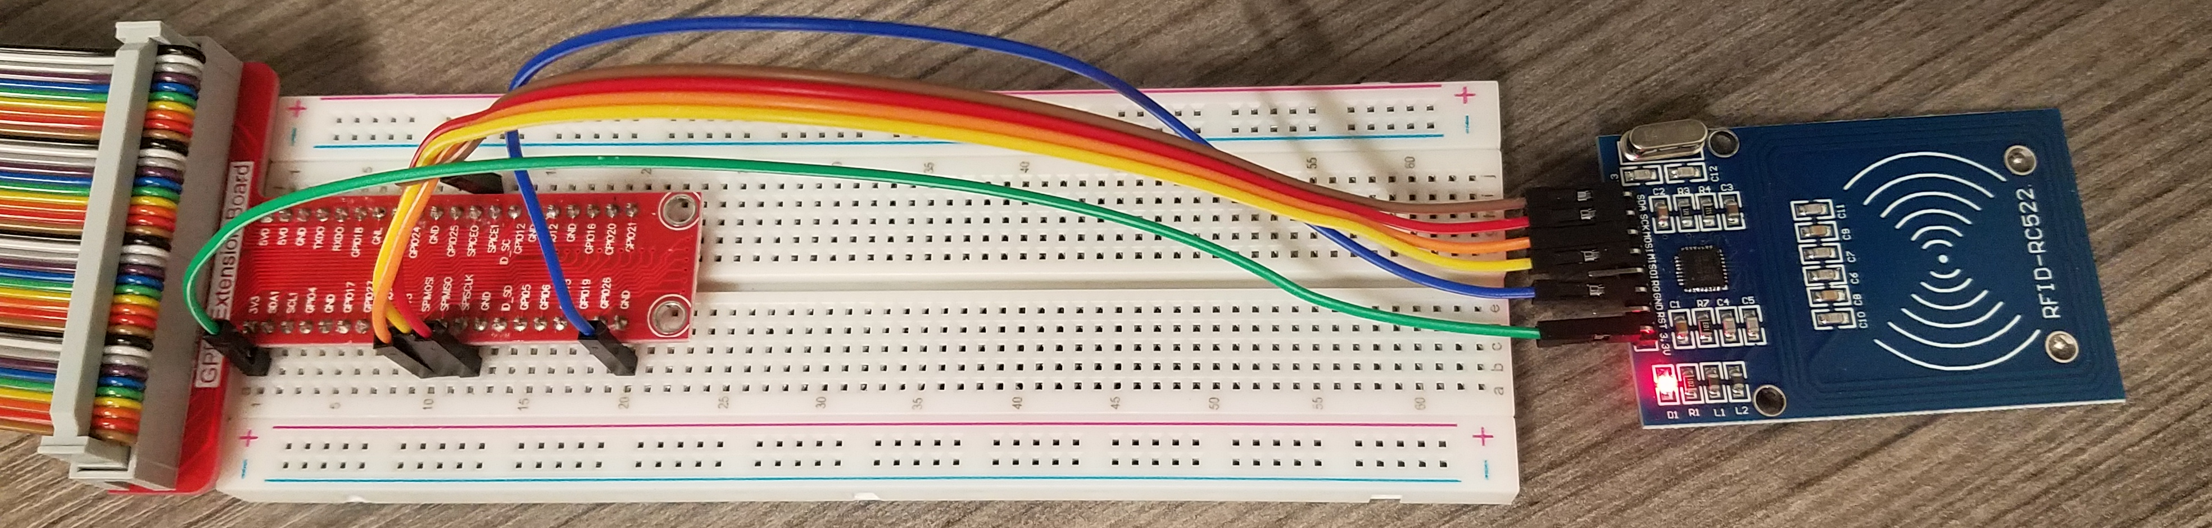
Wiring the RC522 -> Pi
3.3V -> 3v3
GND -> GND
MISO -> SPIMISO
MOSI -> SPIMOSI
SCK -> SPISCLK
SDA -> SPICE0
python3 readrfid.py

Slide 7
Messing around with RFID
Python3 writeToRFID.py
python3 display_rfid_data.py
Connect LCD screen to I2C to see display
Recall VCC -> 3.3V, SDA and SCL to their equivalents

Slide 8
Uses of RFID
Where have you seen it?
Where could it be used?

Slide 9
Multifactor Authentication
Something you know
passwords, pins, security questions
Something you have
RFID card, cell-phone app
Something you are
Fingerprint scanner, face scan
Somewhere you are
Geofence, IP address

Slide 10
Problems with RFID
Speed (typically 40kbps)
Security
Privacy

Slide 11
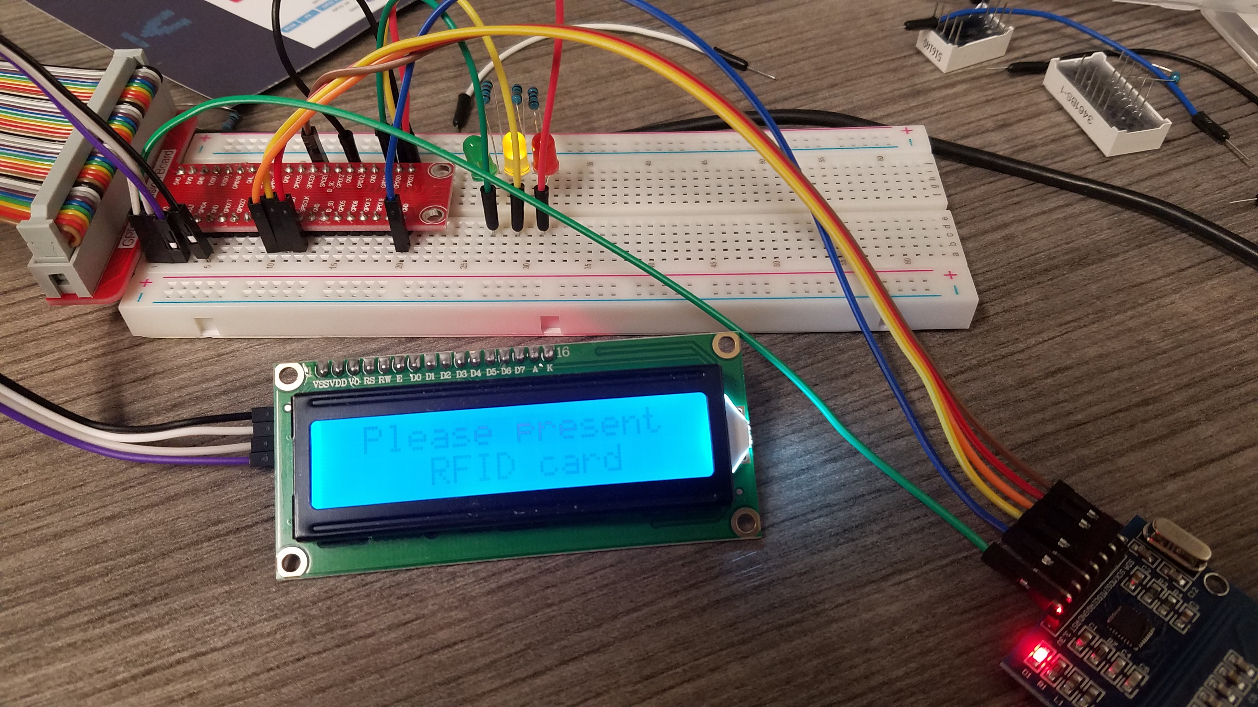
Access Cards
Connect LEDs (with resistors)
Red to GPIO 21
Yellow to GPIO 20
Green to GPIO 16
Enter RFID numbers as separate lines in validcards.txt
python3 access_card.py

Slide 12
Investigation
How can you tell if someone has been attempting to gain access?

